Slide 1
Disaster Preparedness and Response Education System for Schools and Colleges``
Review-1
Roll Number | Student Name
20221CCS0115 | DHANYA D T
20221CCS0113 | C NIHARIKA
20221CCS0128 | BHAVANI
Under the Supervision of,
Dr. Ramesh Sengodan
Professor
School of Computer Science and Engineering
Presidency University
Name of the Program: B.TECH
Name of the HOD: Dr. Anandaraj S.P
Name of the Program Project Coordinator: Dr. Sharmasth Vali
Name of the School Project Coordinators: Dr. Sampath A K , Dr. Geetha A

Slide 2
Content
Problem Statement
Objectives
Background and Related work for title Selection
Analysis of Problem Statement
Innovation or Novel Contributions
Git-hub Link
Timeline of the Project
References

Slide 3
Problem Statement Number: SIH 25008
Category (Hardware / Software / Both) : Software
Problem Description:
Educational establishments, including schools and colleges, do not have a planned, continuous system of disaster preparedness and response training. Disaster awareness is confined to theoretical knowledge or irregular physical drills with no clear-cut mechanism or time for readiness assessment, or participation and response accuracy monitoring. This absence of systematic preparedness can create panic, confusion, and increased risk when disaster strikes. Therefore, the specific digital disaster preparedness and response education is required to
(a) provide knowledge to the participants
(b) conduct simulation-based disaster drills
(c) evaluate the preparedness levels of students and staff in educational institutes regarding disasters.

Slide 4
Objectives:
To educate students and staff about disaster preparedness.
To conduct virtual disaster response drills.
To evaluate preparedness using scoring and analytics.
To help schools and colleges improve disaster readiness.

Slide 5
Background and Related work for Title Selection
Traditional Systems: Disaster preparedness is limited to theory and occasional manual drills in institutions.
Existing Systems: Current disaster management tools focus on real-time response, not education.
Related Work: Simulation-based training improves disaster response and awareness.
Gap Identified: No simple digital system for disaster education and preparedness evaluation in schools and colleges.
Title Justification: The proposed system fills this gap through structured learning and virtual drills.

Slide 6
Analysis of Problem Statement
Technology Stack
Backend: Python with Flask
Frontend: React JavaScript
Database: MySQL/PostgreSQL
Proposed Methodology
Collect disaster preparedness guidelines and safety content.
Categorize disasters (earthquake, flood, fire, cyclone).
Design scenario-based virtual drill workflows.
Develop backend logic for drill evaluation and scoring.
Create a simple frontend for learning and drill interaction.
Store user activity and scores.
Evaluate system based on preparedness score and participation.

Slide 7
Innovation / Novel Contributions
Virtual Disaster Drill Simulation
Scenario-based drills to simulate real disaster response digitally.
Preparedness Scoring System
Quantitative scoring based on learning, drill performance, and consistency.
Institution-Centric Design
Designed specifically for schools and colleges with role-based access.
Region-Specific Disaster Awareness
Focus on disasters relevant to the geographical location.
Lightweight and Scalable System
Simple initial design, scalable for future enhancements.

Slide 8
Github Link
GitHub Link:
https://github.com/dhanyadt/disaster-management

Slide 9
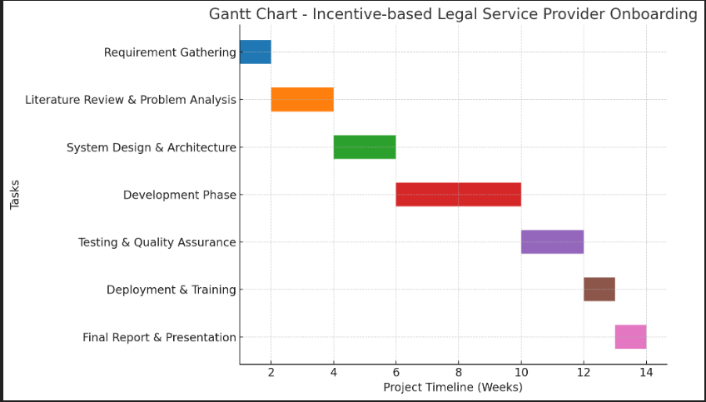
Timeline of the Project (Gantt Chart)

Slide 10
References
United Nations Office for Disaster Risk Reduction (UNDRR), Disaster Risk Reduction in Schools, UNDRR Publications, 2020.
Federal Emergency Management Agency (FEMA), Guide for Developing High-Quality School Emergency Operations Plans, U.S. Department of Education, 2019.
World Health Organization (WHO), Emergency and Disaster Risk Management Framework, WHO Press, 2017.

Slide 11


